Slide 1
Measurement Unit Worksheets
Measurement Principles Part 1 / Worksheet 1
Review of Scientific Notation / Scientific Notation Practice
Measurement Principles Part II / Applying Weakest Link Rules
Units Conversion Worksheet 1
Significant Digits Practice
Sig Digs On-Line (Multiple Choice)
Weakest Link On-Line (Multiple Choice)

Slide 2
Measurement Principles Part 1 / Worksheet
State the number of significant digits in each of the following:
1,203,000
0.001203
0.012030
5 apples

Slide 3
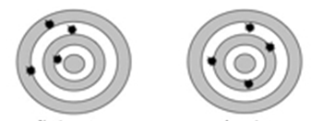
Measurement Principles Part 1 / Worksheet
For each picture state if the result is:
Accurate
Precise

Slide 4
Review of Scientific Notation / Scientific Notation Practice
Round each of the following to the indicated precision:
3.5 to nearest whole number
3.51 to 2 s.d.
0.02499 to 3 s.d.

Slide 5
Review of Scientific Notation / Scientific Notation Practice
Convert the following to scientific notation.
32,500
0.00170
Convert the following to standard notation.
2.30x10⁴
2.30x10⁻⁴

Slide 6
Measurement Principles Part II / Applying Weakest Link Rules
Express the following calculations using appropriate significant digits.
Average of: 2.50, 3.311, and 2.9
Percent difference of: 11.98 and 13.2

Slide 7
Units Conversion Worksheet 1
Convert the following and express the result in scientific notation.
34,500 cm³ = ? hm³

